Slide 1

DATA ENGINEERING 1
JOINS
Laszlo Sallo
OCTOBER 2023

Slide 2

ONE-TO-ONE (1:1) RELATIONSHIP

Slide 3

ONE-TO-MANY (1:N) RELATIONSHIP

Slide 4

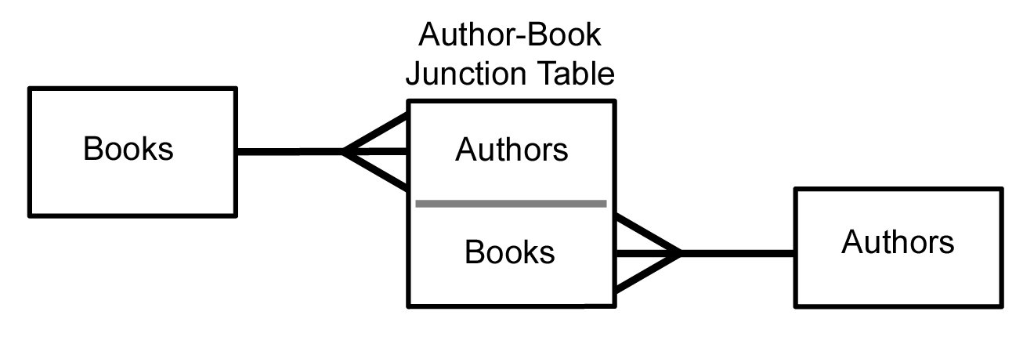
MANY-TO-MANY (M:N) RELATIONSHIP

Slide 5
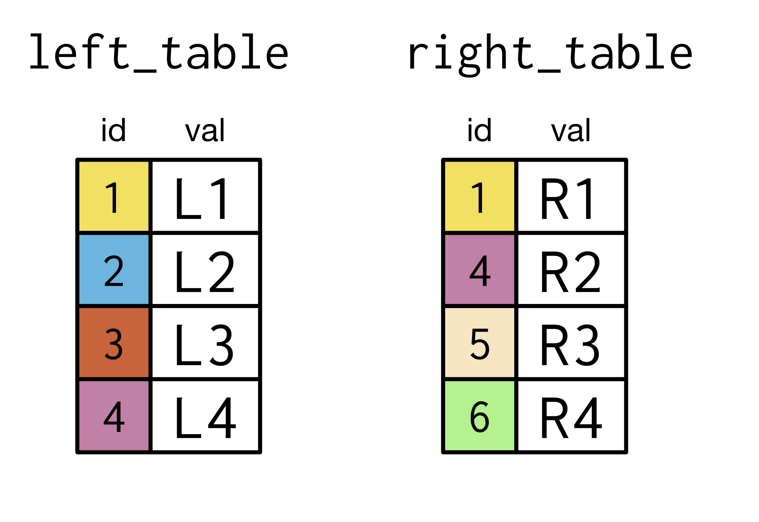
INNER JOIN

Slide 6
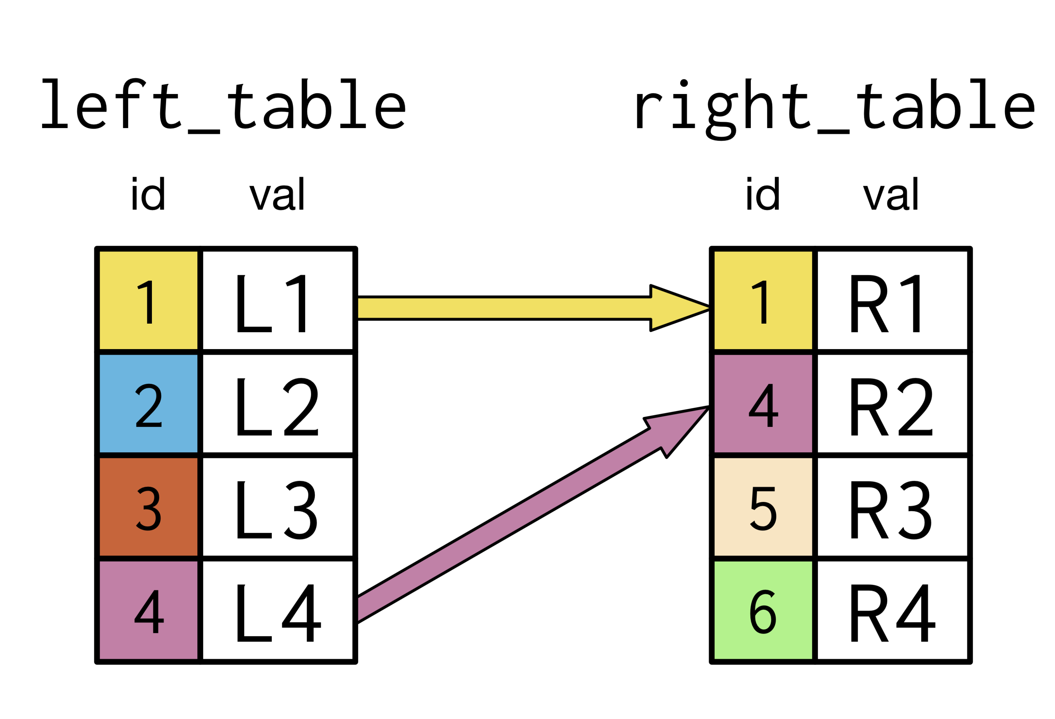
INNER JOIN

Slide 7
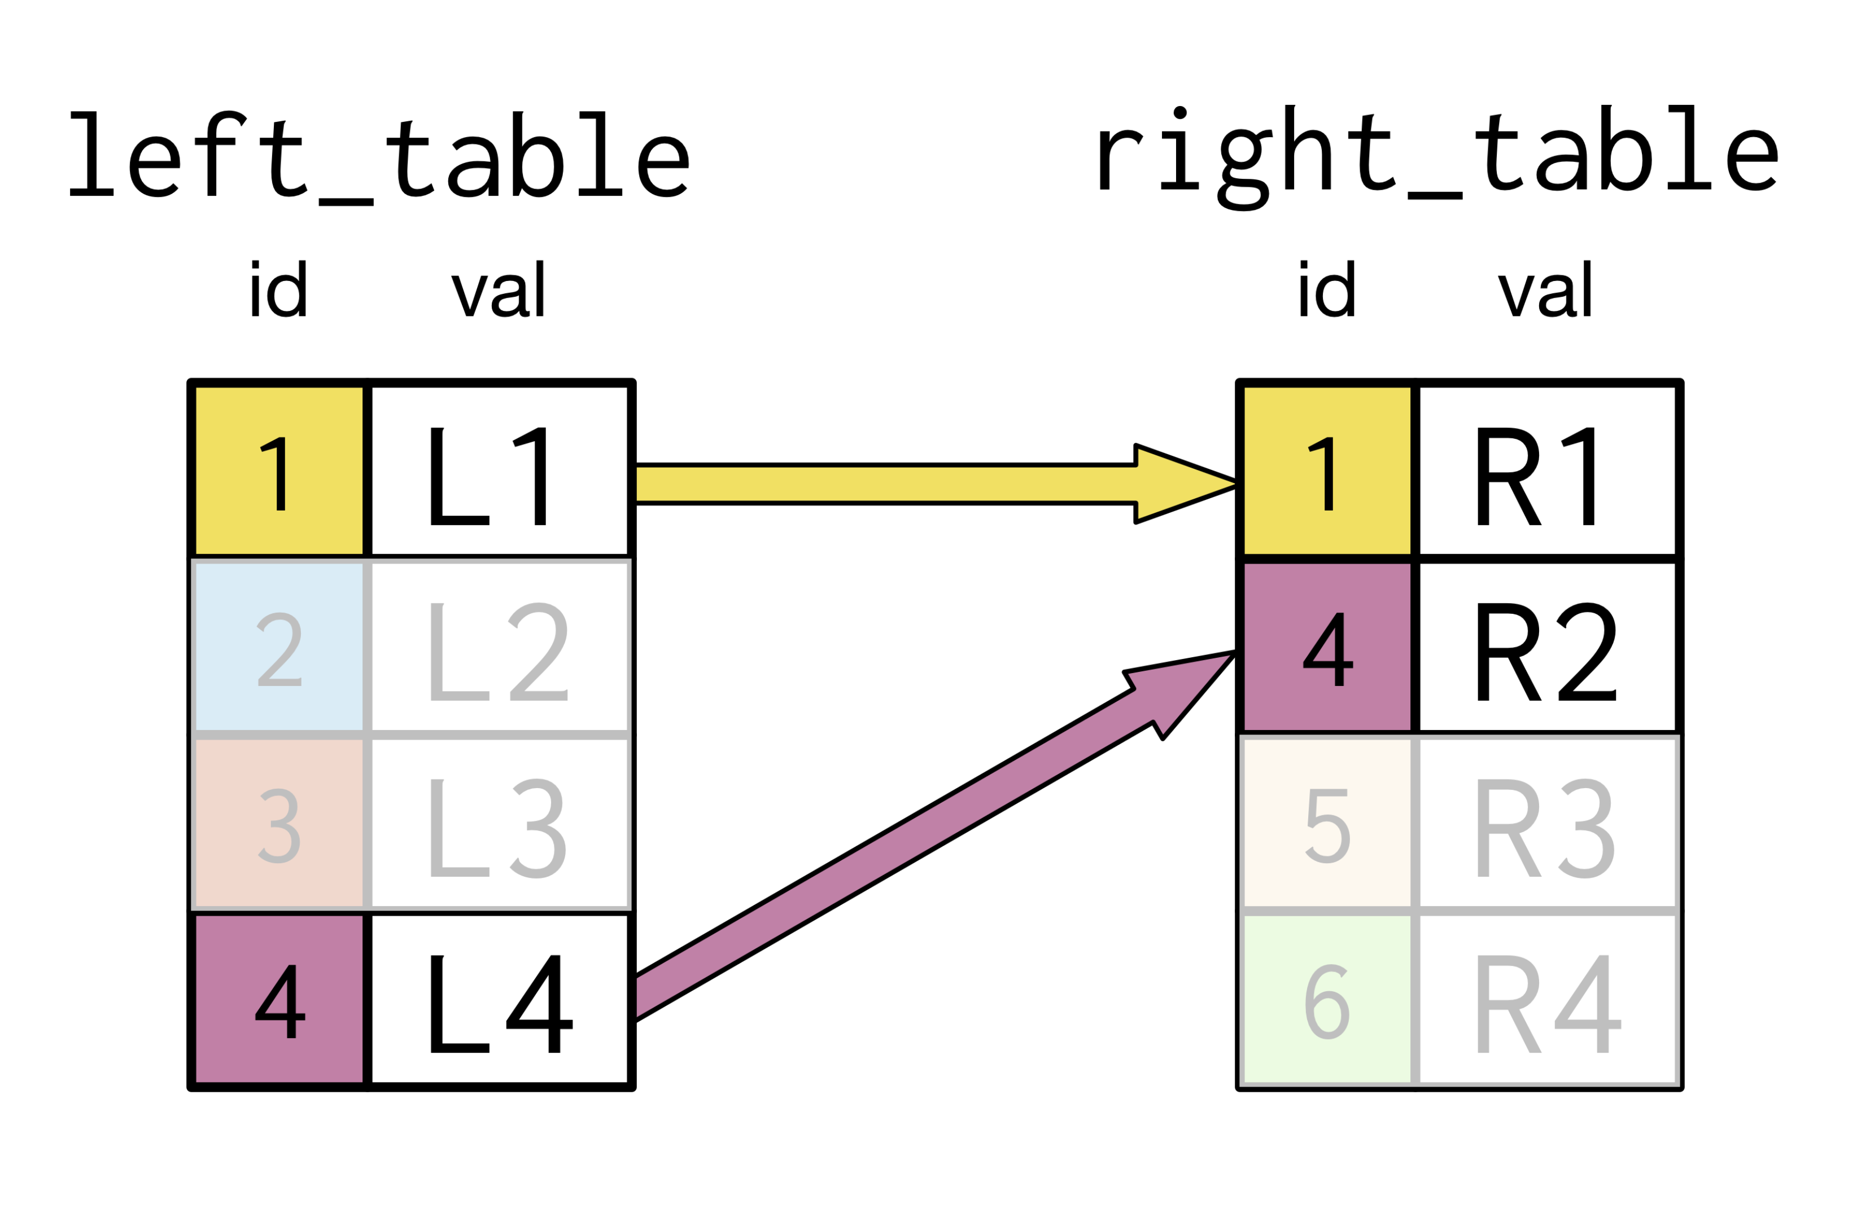
INNER JOIN

Slide 8
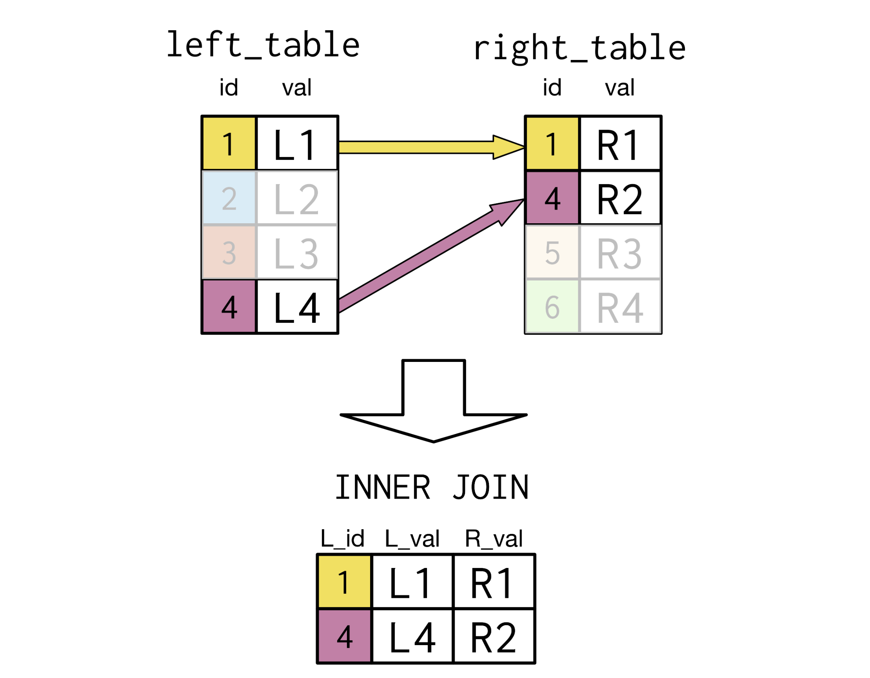
INNER JOIN 1:1

Slide 9
INNER JOIN 1:N

Slide 10
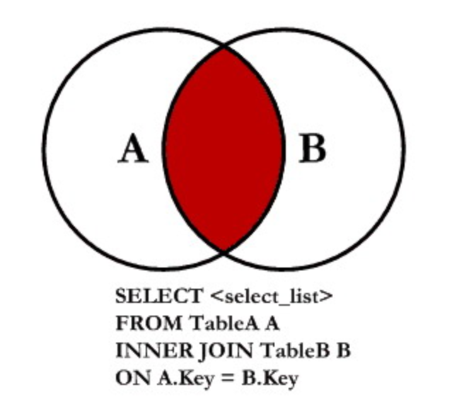
INNER JOIN FORM

Slide 11
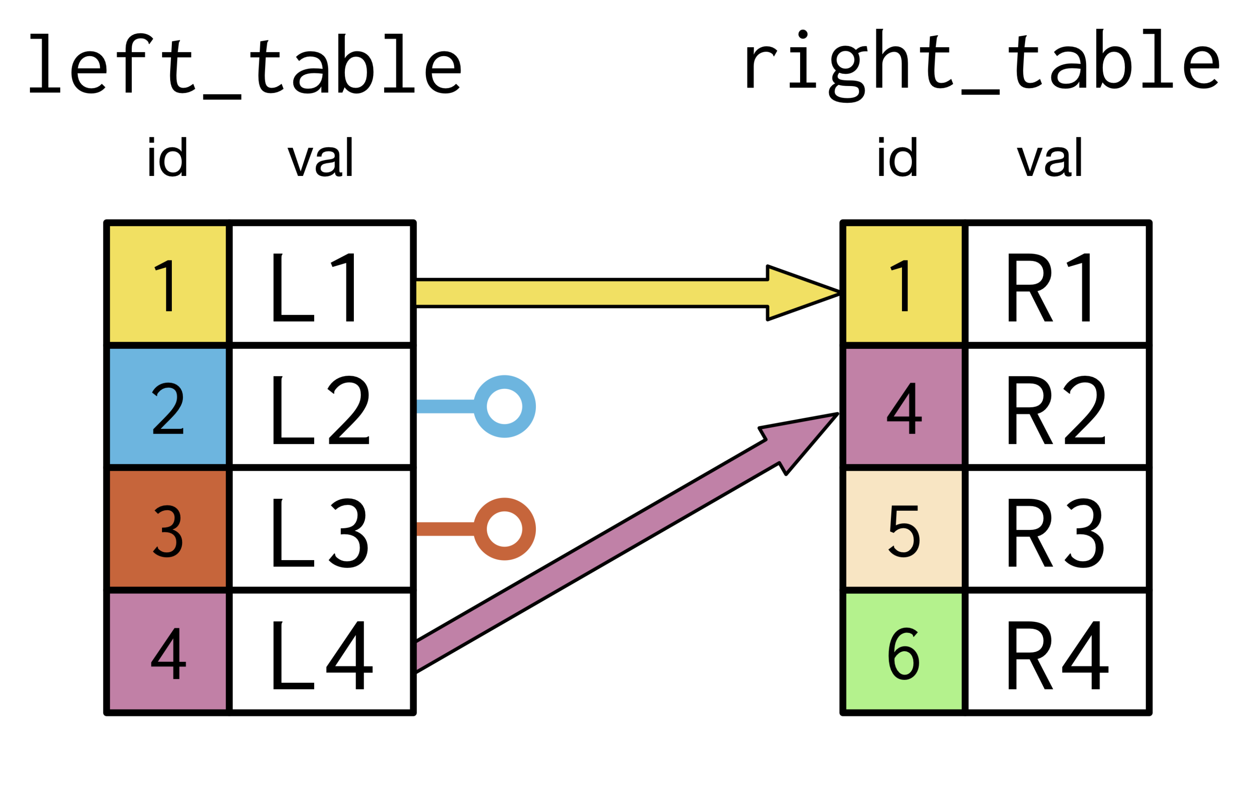
LEFT JOIN

Slide 12
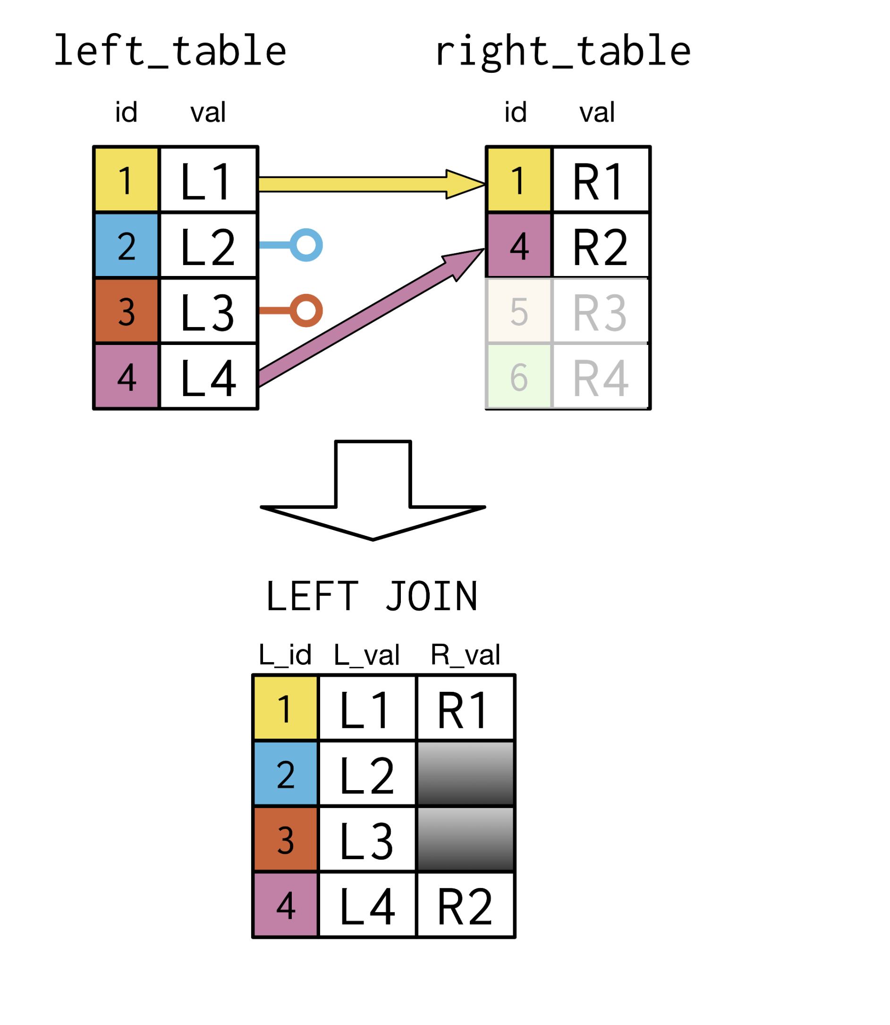
LEFT JOIN 1:1

Slide 13
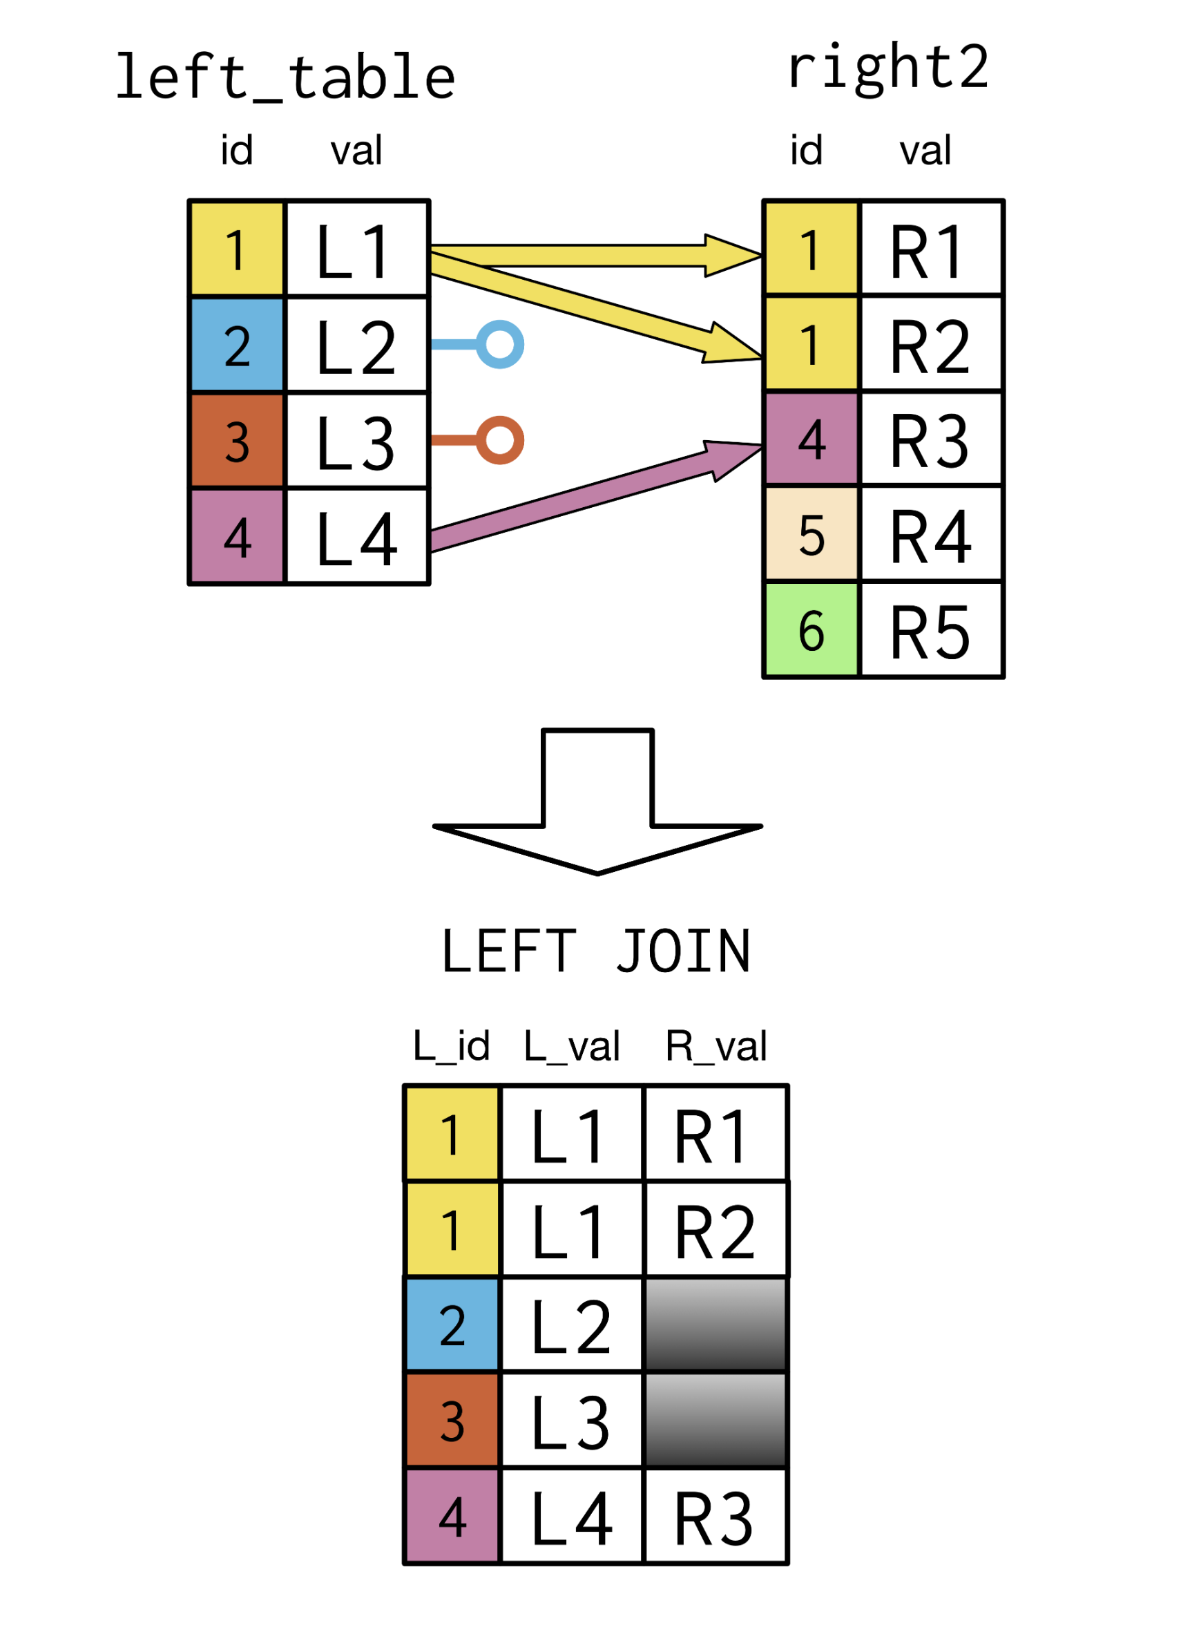
LEFT JOIN 1:N

Slide 14
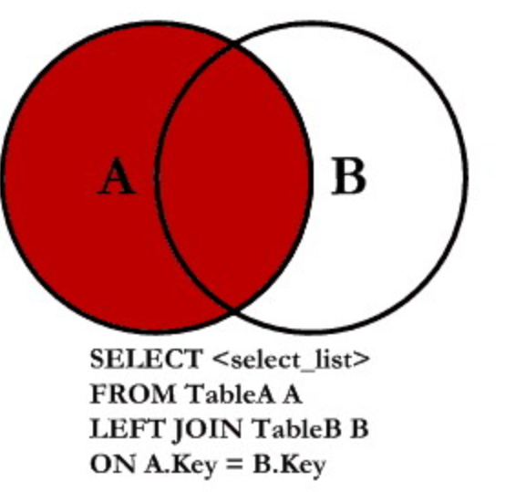
LEFT JOIN FORM

Slide 15
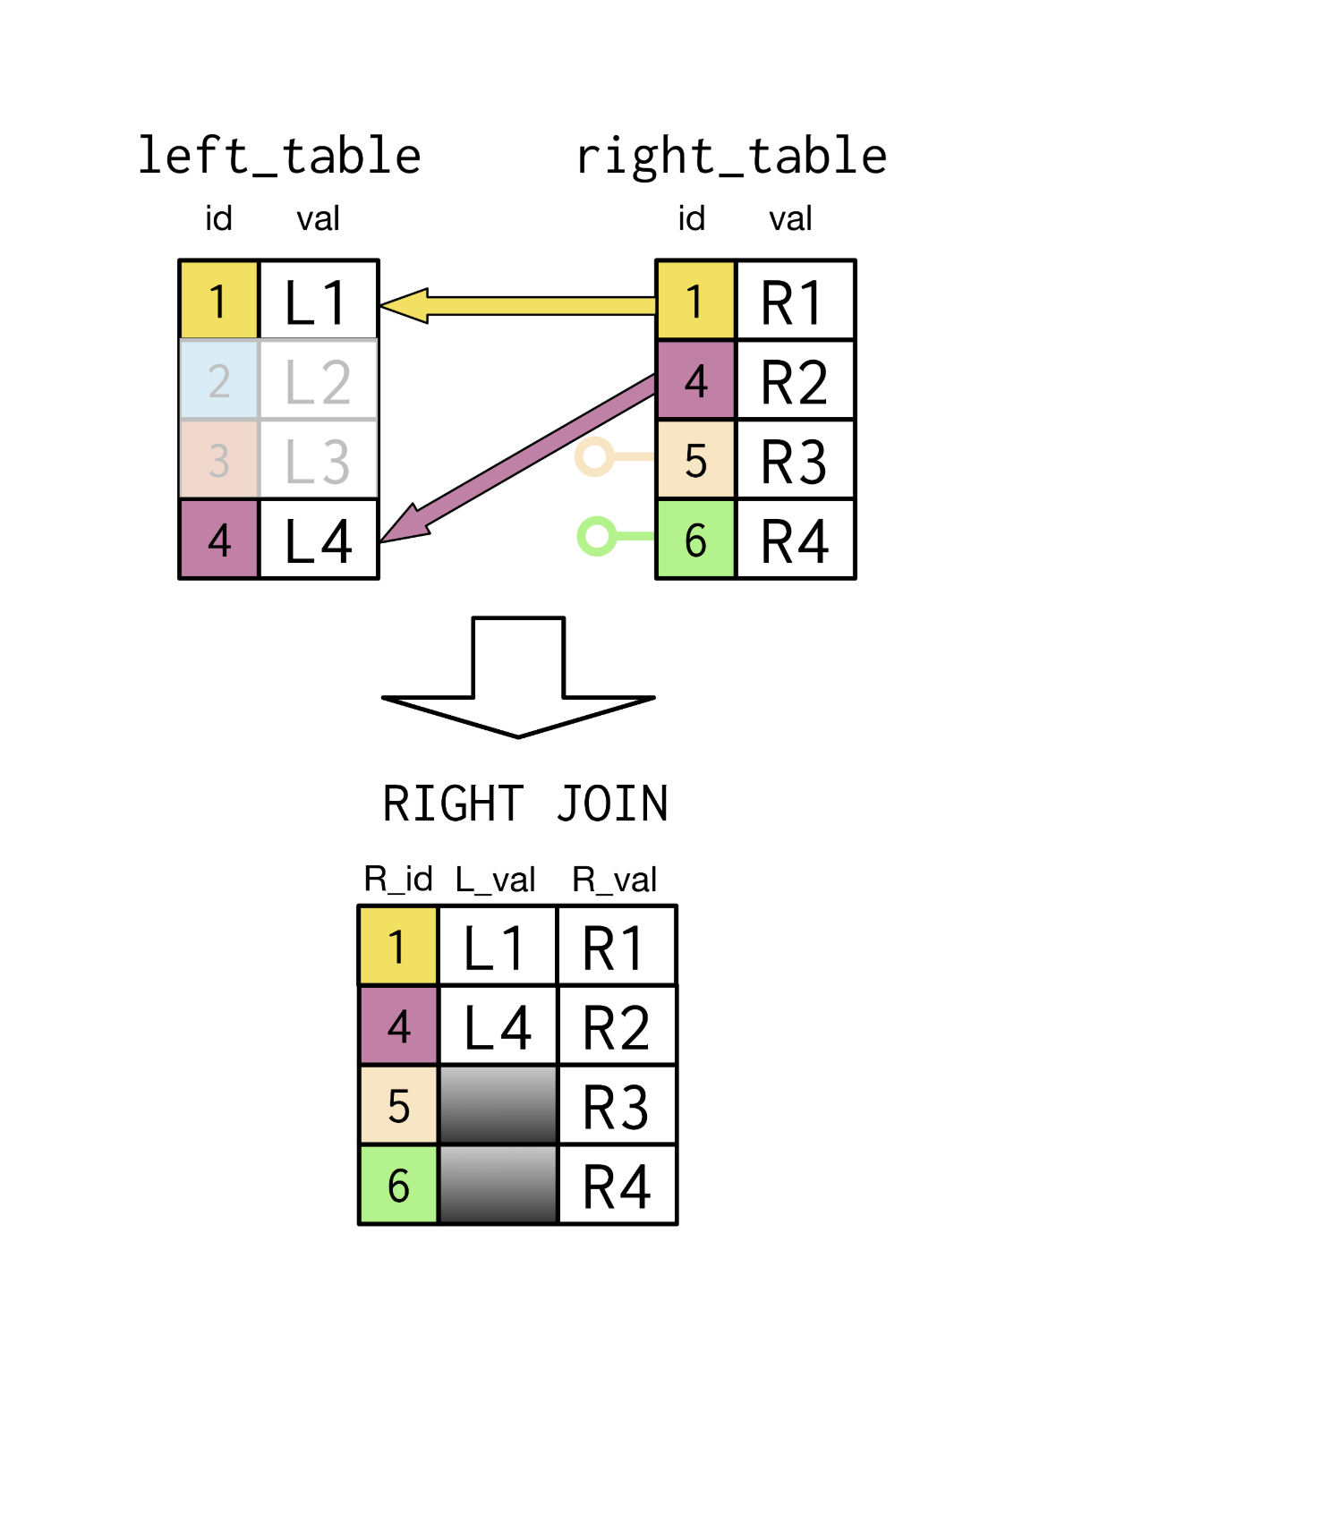
RIGHT JOIN

Slide 16
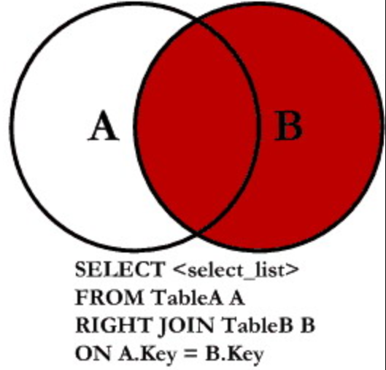
RIGHT JOIN FORM

Slide 17
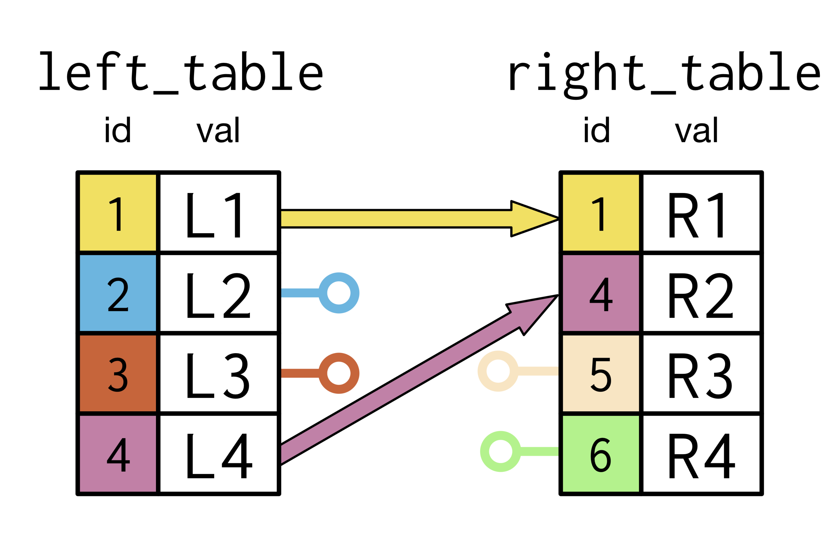
FULL JOIN

Slide 18
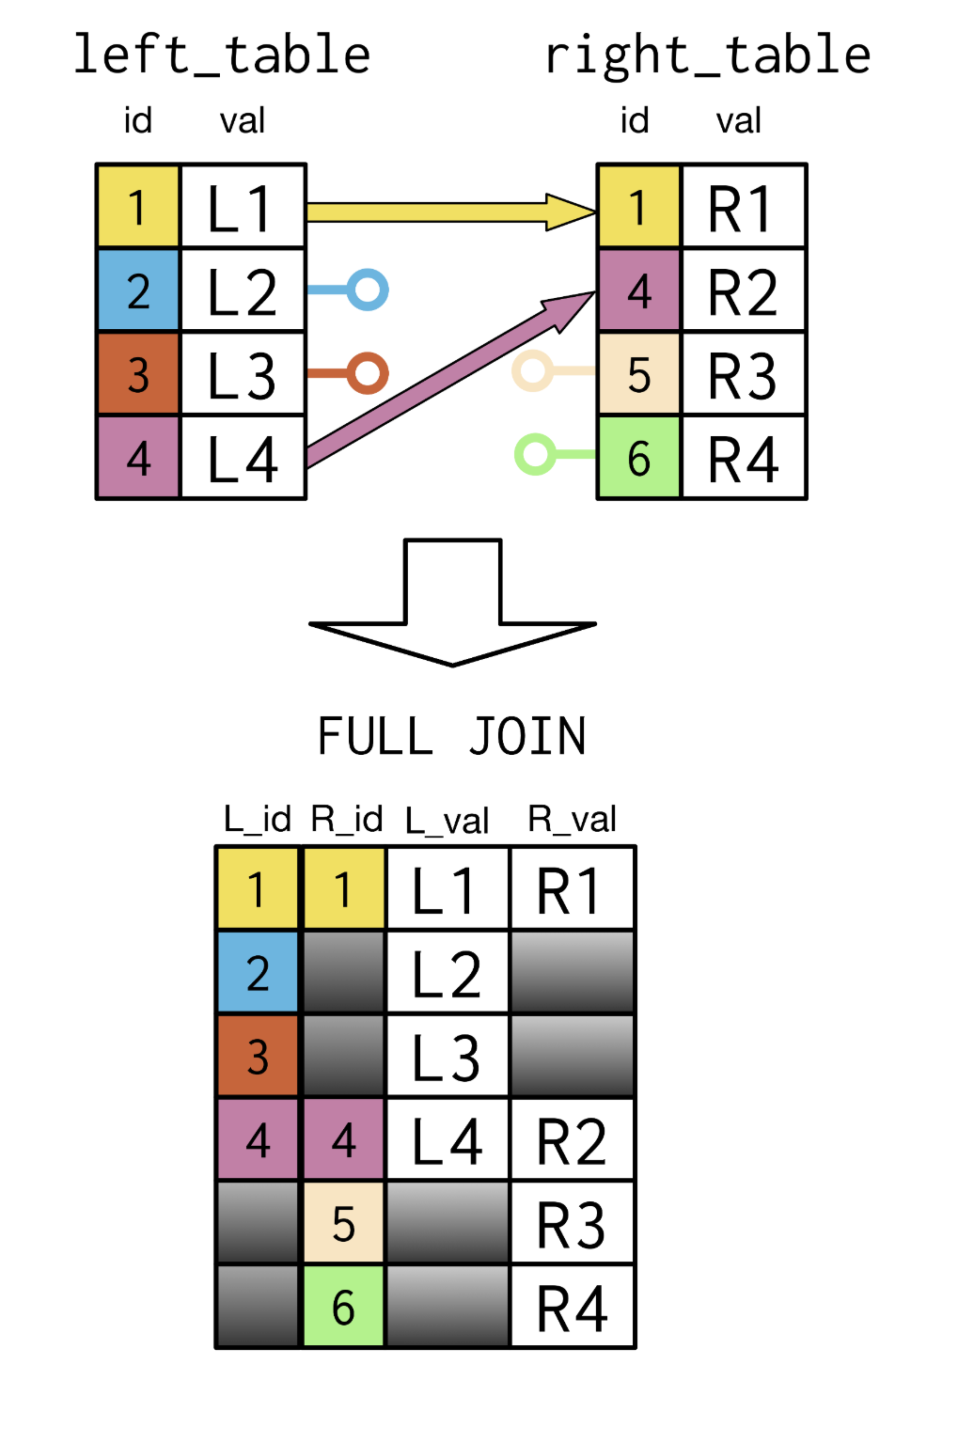
FULL JOIN

Slide 19
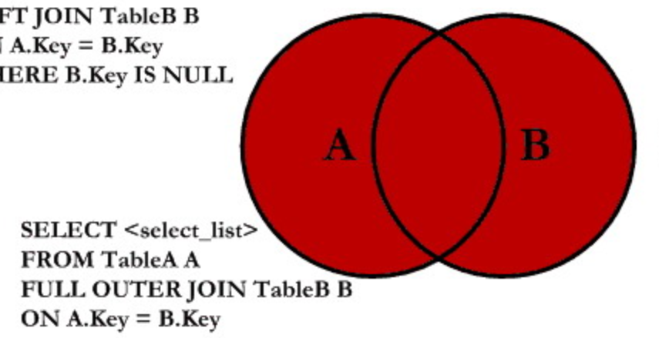
FULL JOIN FORM

